Slide 1
Accessibility is a Civil Right
The CSUN 40th anniversary
U.S. Digital Accessibility Legal Update
Lainey Feingold | LFLegal.com | LinkedIn | BlueSky
March 13, 2025
**No legal advice in this talk**

Slide 2

Check-in #1
Fear | Anger
Uncertainty
Pain
Frustration + confusion
Overwhelm
Absence of hope
Feeling of powerlessness

Slide 3

Check-in #2
Strong legal protections
Legal resistance
Sources of hope + power
Accurate information
Community

Slide 4
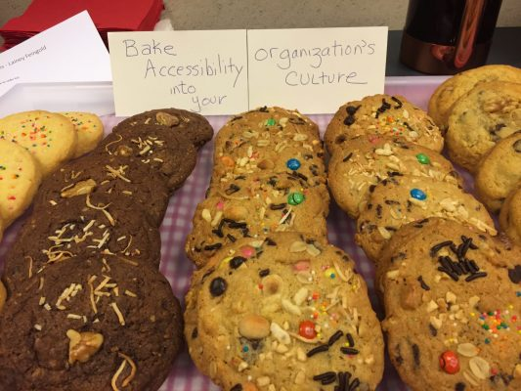

Today’s roadmap
What is digital accessibility
US a11y legal framework
Remedies for legal violations
Enforcement strategies
Staying current + resources
Risks
Power sources (hope)
Accessibility is Delicious

Slide 5
What is digital accessibility?

Slide 6


Engine of disablity inclusion in tech
The difference between inclusion + exclusion for disabled people
Intentional practices that make inclusion happen
Privacy, security, safety +++ for disabled people
You are a door opener!

Slide 7

Digital access is a bridge to everything
You are a bridge builder!

Slide 8
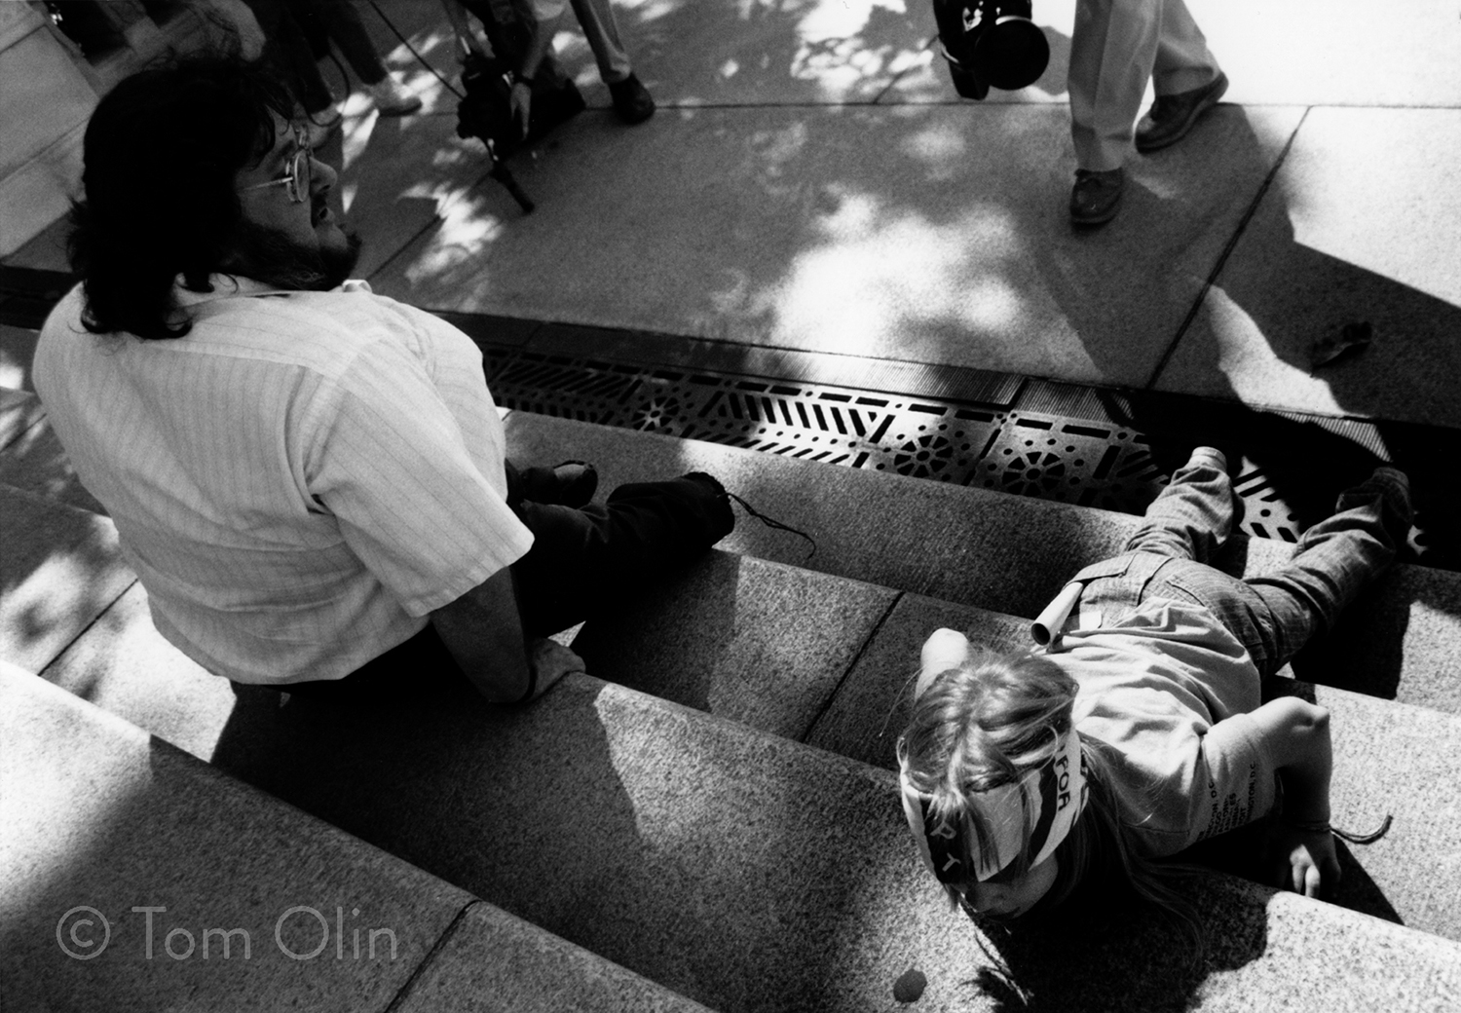
Digital accessibility is a civil | human right
Participation
Inclusion (Exclusion)
Communication
Education
Health and safety
+++
You are a civil rights enforcer!

Slide 9

Rights are baked into laws

Slide 10
What is the Digital Accessibility Legal Framework in the US?

Slide 11

Digital A11y Legal Framework Components
Federal laws
Federal regulations based on federal laws
Federal agency policy statements
State and local laws and regulations
Global laws impacting US businesses
Implementation + Enforcement

Slide 12
Framework Part 1
US Federal Laws, Regulations, Agency Actions

Slide 13
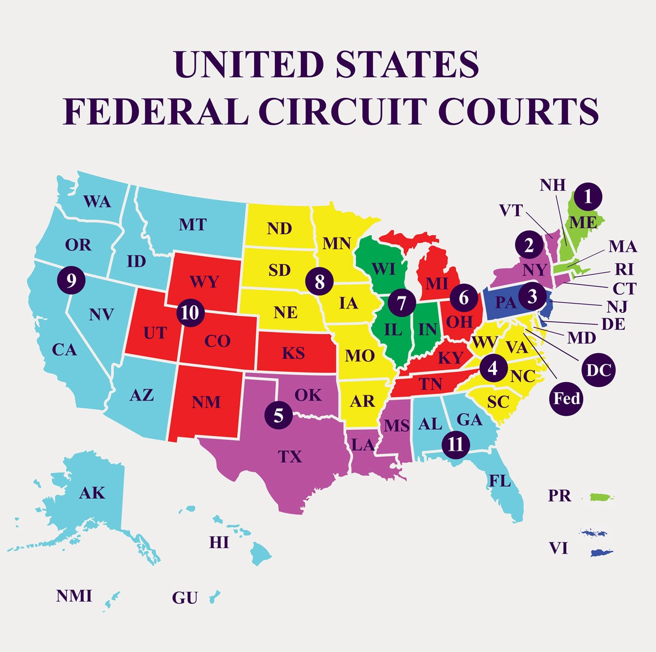
Existing federal laws + regulations
ADA (since 1990)
  Anti-discrimination
  Effective communication (aux aids + services)
  Digital since 1996
  2024 web + mobile rule
Section 504 | 508
CVAA + FCC regulations
Air Carriers Access Act
ACA section 1557
Laws not related to disability rights

Slide 14
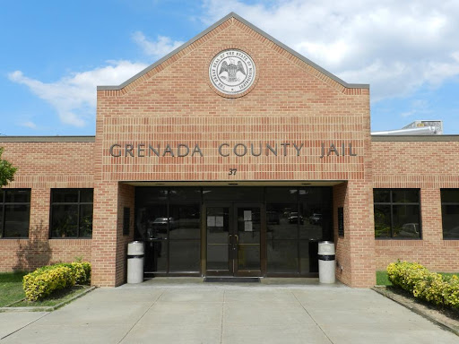
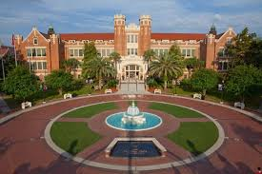

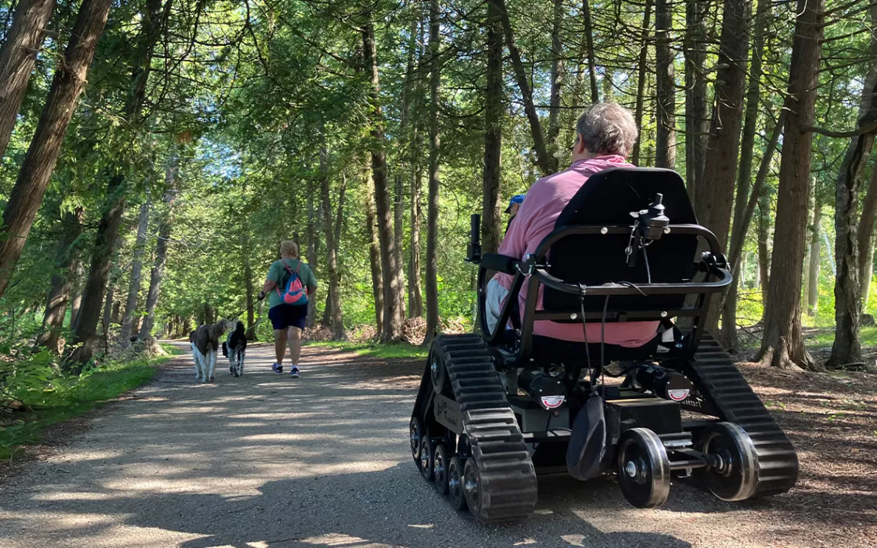
New: ADA web + mobile rule
State and Local Government only
WCAG 2.1 AA
Time frame
  But ADA not suspended!
  New Louisiana case (LFLegal)
Fact Sheet: New Rule on the Accessibility of Web Content and Mobile Apps
Video: ada.gov/title-ii-web-rule/

Slide 15

What’s the risk to existing Federal laws + regs
Will ADA change?
Will ADA regulations change?
  EPA as model?
Can private lawsuits challenge laws + regs
  Yes: 504 challenge (DREDF)
What can judges do?
  Chip away | take away rights
What can Congress do?

Slide 16
Executive Orders
DEI Executive Orders (Eve Hill articles on LFLegal)
Slight back-track on DEIA
OPM Feb 5 memo
LFLegal: bit.ly/OPMa11y
…Agencies should not terminate or prohibit accessibility or disability-related accommodations, assistance, or other programs that are required by those or related laws.
In executing reduction-in-force actions regarding employees in DEIA offices, agencies should therefore retain the minimum number of employees necessary to ensure agency compliance with applicable disability and accessibility laws, including those requiring the collection, maintenance, and reporting of disability information.

Slide 17

Will there be new laws + regs?
X
Websites and Software Apps Law (fed)
Communications, Video, and Technology Accessibility Act (CVTA)
Section 508 Refresh Act (2024)
CA Bill AB 1757
Self service transaction terminals (kiosks)
EV charging stations
Dept. of Education update

Slide 18
Where’s the power to protect fed’l laws + regs
Disability / civil rights lawyers challenging trump + Winning!
  Track the lawsuits
Protecting laws in court
Staying the accessibility course
Bi-partisan support for ADA (?)
Complex process for rule change
Fair judges + Blue State AGs

Slide 19

Power of states to push back against federal lawlessness
“Employment policies incorporating diversity, equity, inclusion, and accessibility best practices are not only compliant with state and federal civil rights laws, but they also help to reduce litigation risk by affirmatively protecting against discriminatory conduct that violates the law.”
--MA + 15 States
Feb 13 State AG Guidance!
bit.ly/DEIATruth: (LFLegal article about state DEI Guidance)

Slide 20

Beyond Laws + Regs: US Agency Guidance
EEOC, DOJ, HHS, DOE
Telehealth + AI
Workplace + Higher Ed
Resources: LFLegal.com

Slide 21
What’s the risk to Federal Agency Guidance
Can be rescinded
No new helpful agency guidance
Harmful agency guidance

Slide 22
Where’s the power to protect Federal agency guidance?
WayBack machine
Substance of deleted guidance may still useful
LFLegal “broken links” article

Slide 23

Don’t Obey in Advance
--Timothy Snyder, On Tyranny

Slide 24
Framework Part 2
US States + other Countries

Slide 25
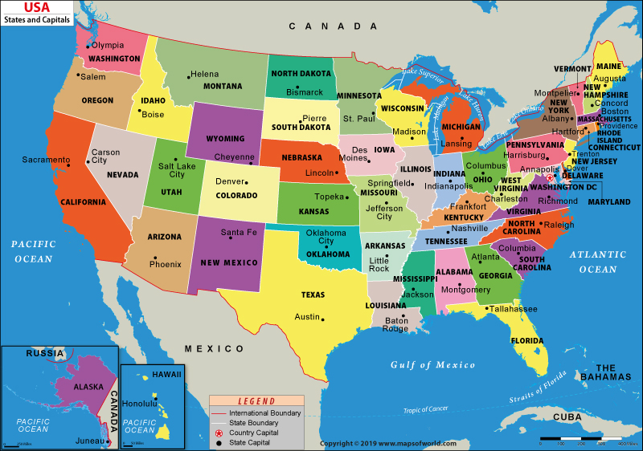
U.S. State and Local Framework
Anti-discrimination
State-funded + purchased
State agencies
K-12 procurement
Accessible prescription
Resource: LFLegal Global page (U.S.)

Slide 26

Global Framework
US companies impacted by European Accessibility Act
US Companies impacted by Rights for Persons with Disabilities (RPwD) Act in India
LFLegal.com/global-law-and-policy/
Accessibility is global!

Slide 27
What’s the risk to state, local + global laws
States could weaken disability rights laws
  Limit right to sue
Court interpretations

Slide 28
Where’s the Power: State, local + global laws
States could strengthen disability rights
New states could adopt laws
Court interpretations +
Not affected by federal executive or agency actions
EU, India ++ unaffected by US

Slide 29

Today’s roadmap
What is digital accessibility
US a11y legal framework
Remedies for legal violations
Enforcement strategies
Staying current and resources
Risks + power sources

Slide 30
What are the remedies if the law is ignored?

Slide 31


Laws include legal remedies
Fix barriers | fix systems
Court / Agency oversight
DOJ penalties (up to 150K)
Pay the disabled person/s
Pay disability rights lawyers
Pay lawyers to ‘defend’
EAA fines, market loss, jail

Slide 32
How are Laws Implemented and Enforced?

Slide 33

Who and How?
People with disabilities
Private party lawsuits
Structured Negotiations
Covered organizations doing the right (and legal!) thing
Government agencies

Slide 34
Access to healthcare: private enforcement
UNC Health Care System PRIVATE lawsuit
$150,000 from Nash Hospital (damages + fees)
$125,000 from UNC Health (damages)
3-year injunction against UNC Health to provide equally effective access to patient communications within entire UNC Health network
More than $1.2 million in attorneys' fees to plaintiffs’ lawyers

Slide 35

Access to education: private enforcement
LACCD (private party)
  $240,000 verdict (2023)
  Verdict reduction + weak injunction (2024)
Earlier settlements as roadmaps
  CUNY
  UC Berkeley
  Harvard | MIT
  Miami University Ohio

Slide 36

Private lawsuit web site numbers – 2024
4,224 cases filed
961 against defendants already sued
99% about desktop websites
1,023 against companies using an overlay
Source: UsableNet

Slide 37
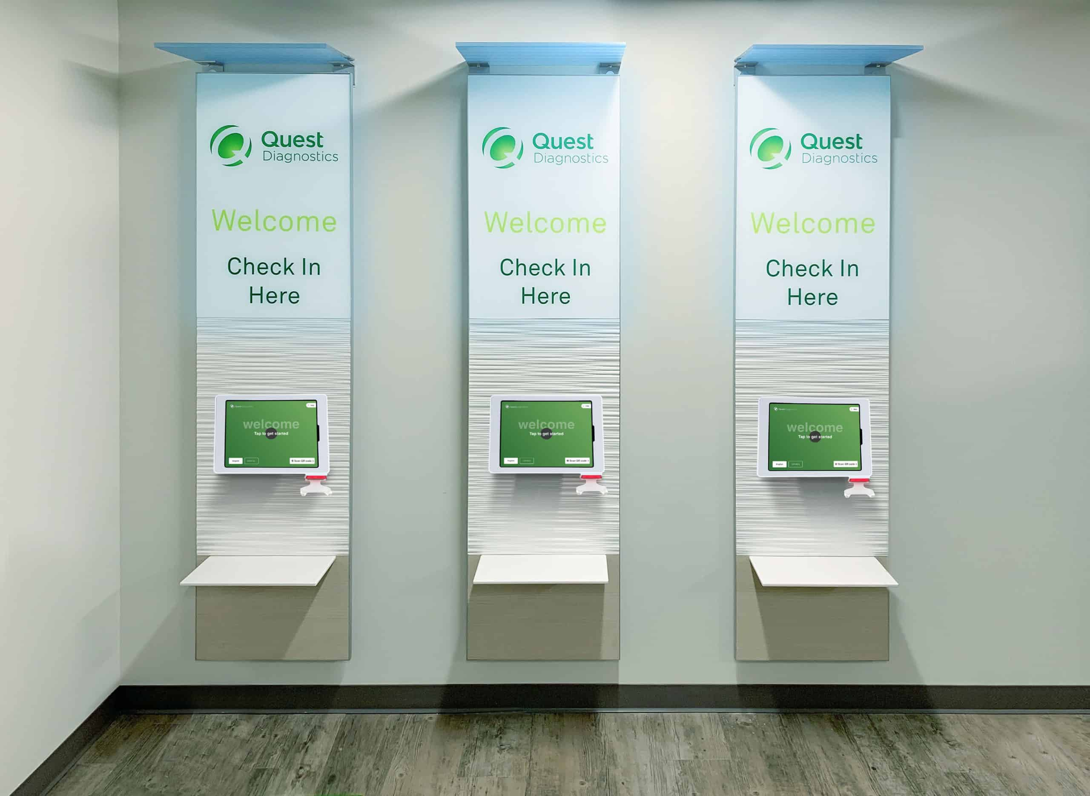


Beyond Websites
Private Party Enforcement
Kiosks
  Quest and LabCorp
  CVS Health hub
  EAA
VR captions
  Panarra v. HTC
Podcast transcripts
  Sirius XM lawsuit
Resources on LFLegal.com

Slide 38
Using other laws to enforce disability + accessibility rights

Slide 39

Using False Claims Laws against web developers
California Parks Web case
  False Claims Act
  Contractor + the web dev + subcontractor sued
  Resolved!!
    Two million dollars
    Fix barriers

Slide 40

Using Fair Dealing Laws against Overlay Companies
Tribeca Skin Care vs. AccessiBe
BloomsyBox vs. UserWay
Breach of contract
Breach of “good faith and fair dealing”
FTC action (?)
Resource: LFLegal.com

Slide 41
What’s the risk to legal remedies + enforcement: Dept. of Education
  Staff Firings 3.11.25
    1,315 employees fired
    Nearly 50% of workforce
    7 of 12 regional offices closed
    60% of Gen’l Counsel staff
  No complaint investigation
    Growing backlog
    Disability / not race and gender bit.ly/OPMa11y
  EndDEI.ed.gov

Slide 42
What’s the risk to legal remedies + enforcement: Dept. of Justice
No Agency / US Attorney action
  No Statement of Interest
  No Guidance | No lawsuits
  No settlements
  No investigation of agency complaints.
Harmful DOJ
Possible ADA change to lawsuit remedy

Slide 43
Where’s the power: remedies + enforcement
Private enforcement
State enforcement
  (NY Attorney General in 2009!)
Orgs doing the right thing
Disability community advocacy

Slide 44
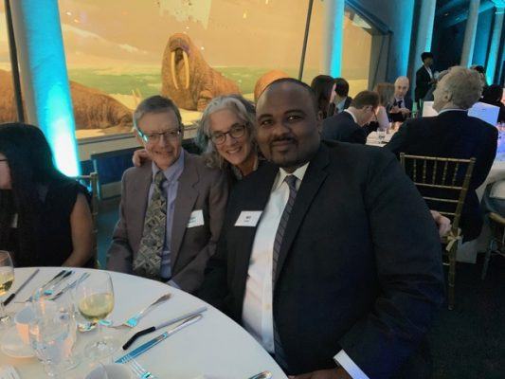
Collaborating on a11y makes people happy
“Helping to build more accessible banking products has been one of the most satisfying parts of my career as an attorney for Bank of America.
In addition, bringing the collaborative approach to my practice has, I think, made me a more effective lawyer and, perhaps, a happier person.”
Brian Frumkin, B of A Lawyer

Slide 45

Staying current about a11y law
Agency email lists???
LFLegal social media + email list (LFLegal.com)
Seyfarth ADA Title III blog for (ethical) defense perspective
Equal Entry Podcast
Converge Accessibility
Accessiblilty in the News
Brown Goldstein & Levy

Slide 46

Accessibility is a journey
Beautiful, historic, bumpy

Slide 47
“Being in accessibility can be soul-crushing.”
“It's positive things and success stories of our work that keeps us going.”
—Lucy Greco,

Slide 48


Taking care of ourselves
LFLegal Digital A11y Joy Plan

Slide 49
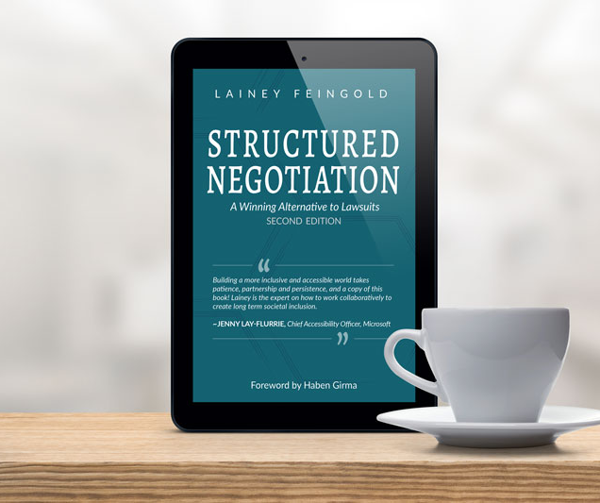
Questions
Lainey Feingold
@LFLegal
LFLegal.com
  [Advocacy, Book, Speaking, Training, Consulting, mailing list]
LF@LFLegal.com

